Slide 1
Financial forecasting by ML

Slide 2
Stock prices prediction by ML
Design and implement an effective system for prediction stock prices is very difficult.
Predicting changes in stock prices is an imperfect science. There is no proven way that can consistently tell an investor exactly how stock prices will behave. This is because there are many other factors, such as economics and politics, as well as fundamental and technical factors, that can influence investor decisions.
In this lecture, we Illustrate how to apply ML learning techniques to discover some “signals” for predicting the moving of stock prices.

Slide 3
Data collection
Some free resources for collecting stock prices data
Yahoo Finance
Google Finance in Google Sheets
IEX Cloud
AlphaVantage
World trading data
Polyon.io
Intrinio
Quandl

Slide 4
A “unified” way to access these sites: pandas-datareader
After importing pandas-datareader in Jupyter notebook, we can use their datareader method to obtain prices of stocks in various markets.

Slide 5
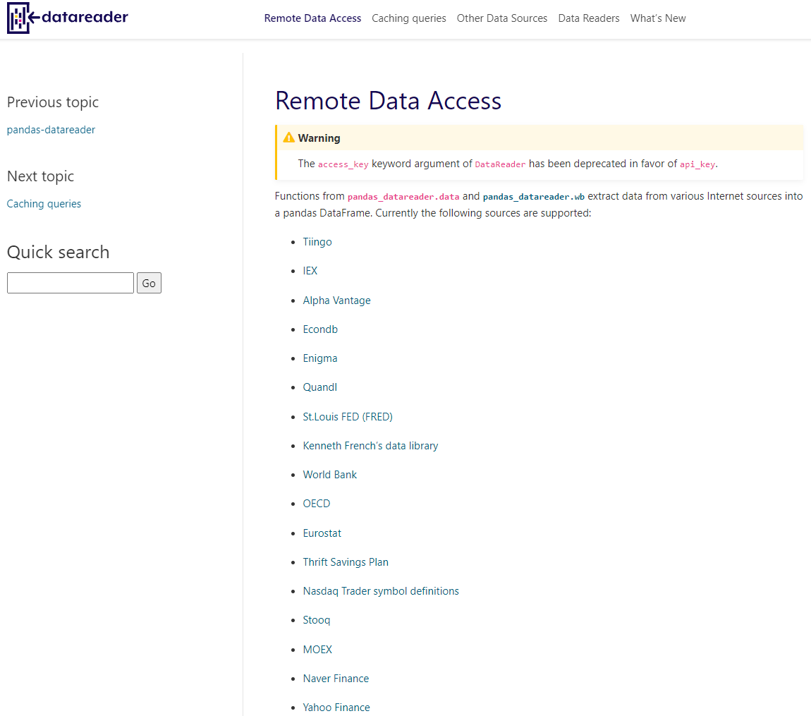

Slide 6
Stock market basic: stock ticker
The ticker (股份編號, 股票代码) of a stock is a unique “code” given by a particular trade market for the general public to identify the stock. Different markets have different formats.
Examples
In US, a stock ticker is a string of letters, e.g., Apple Ic.’s ticker is the string “AAPL”
In Hong Kong, a stock ticker is a “number”, e.g., PCCW’s ticker is 0008, MTR’s ticker is 0066.

Slide 7


It is easy to find out the ticker of a stock
0066.HK
AAPL

Slide 8

It is easy to find out the ticker of a stock

Slide 9
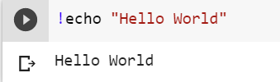

Extra installation
To use pandas to access yahoo’s stock data, you need to install yahoo’s library yfinance (only for CoLab).
After import pandas-datareader, your program can use its get_data_yahoo method to obtain prices of various stocks from yahoo.
How to install?
invoke an OS system
command
d

Slide 10
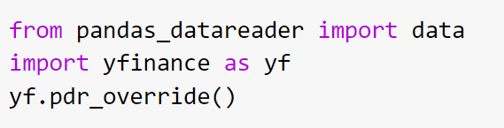
Get ready to start
Notice that it has not imported numpy and pandas. It is because
pandas_datareader depends on
pandas, and pandas depends on
numpy, and colab import them
implicitly. But as a beginner, you
should play safe and import all the libraries your program needs.
override yfinance with pandas

Slide 11
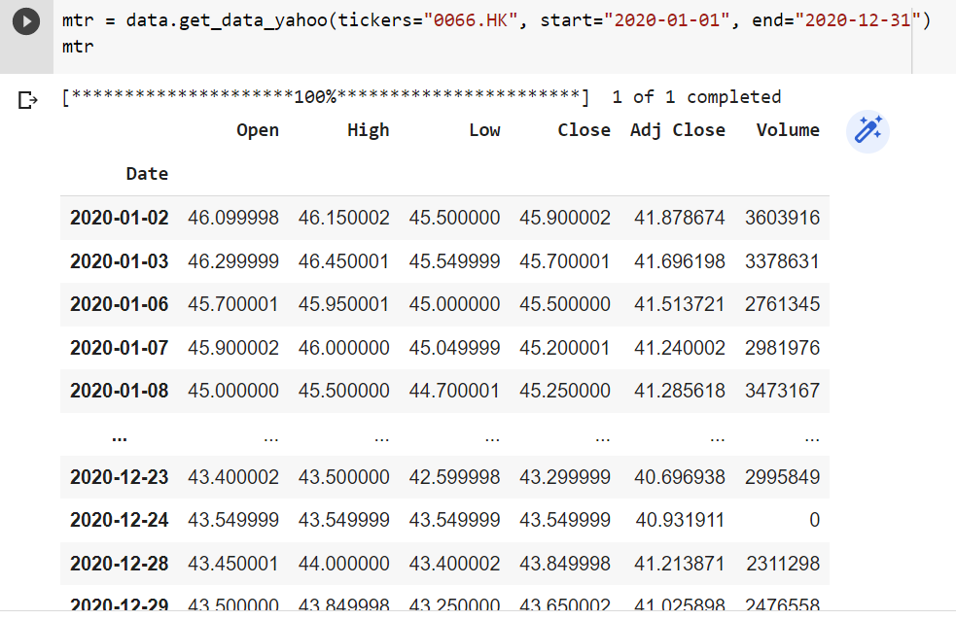
Getting stock prices of MTR
specify the market

Slide 12
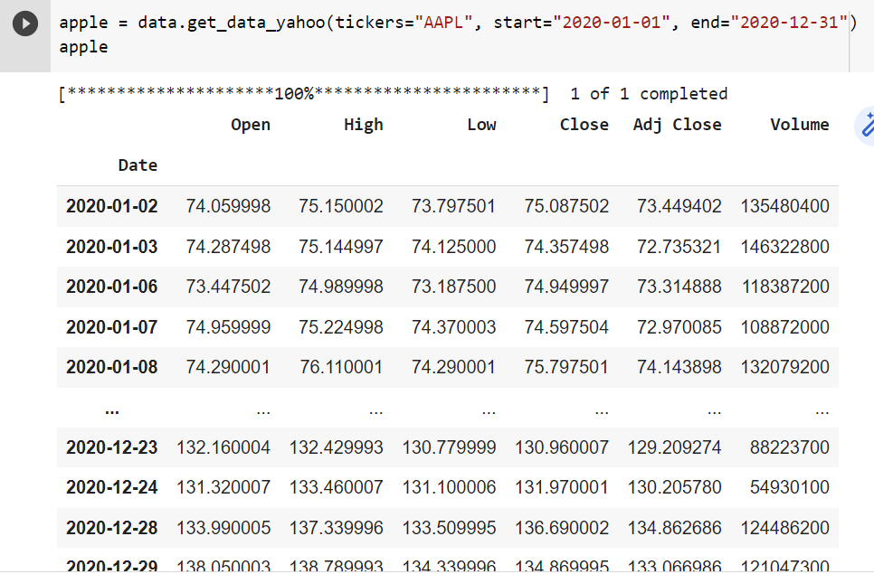
Getting the stock prices of Apple
No need to specify the
market for US

Slide 13
Data collections
Ticker for some major international and local companies
Company | ticker
Intel | INTC
Microsoft | MSFT
IBM | IBM
Apple | AAPL
Amazon | AMZN
Coca-Cola | KO
Google | GOOG
Hong Kong Bank | 0005.HK
PCCW | 0008.HK
MTR | 0066.HK
Hutchison | 0001.HK

Slide 14
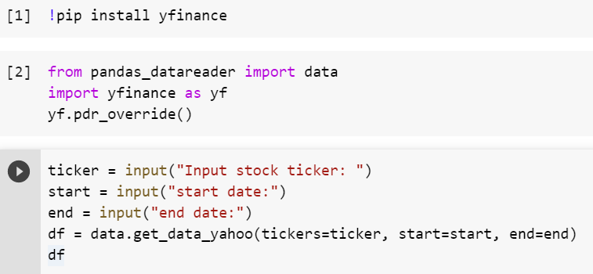
Getting general stock example
parameter name
argument variable name
no problem the two names are
the same; Python and handle it

Slide 15
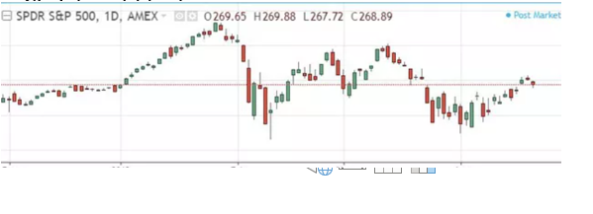
Candle Stick chart for stock prices

Slide 16
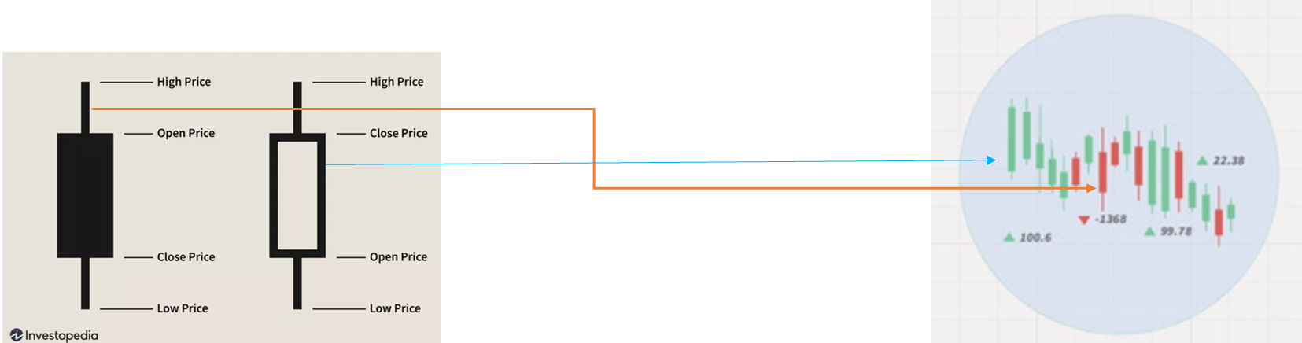
Candle Stick chart for stock prices

Slide 17
Candle Stick chart for stock prices

Slide 18
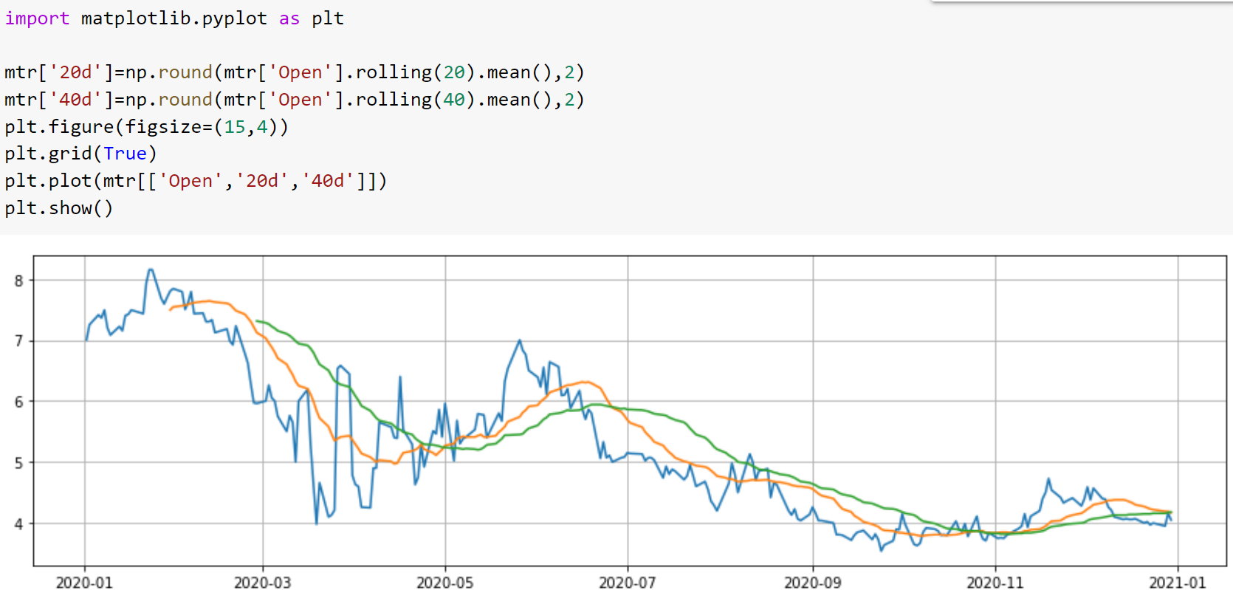

Slide 19
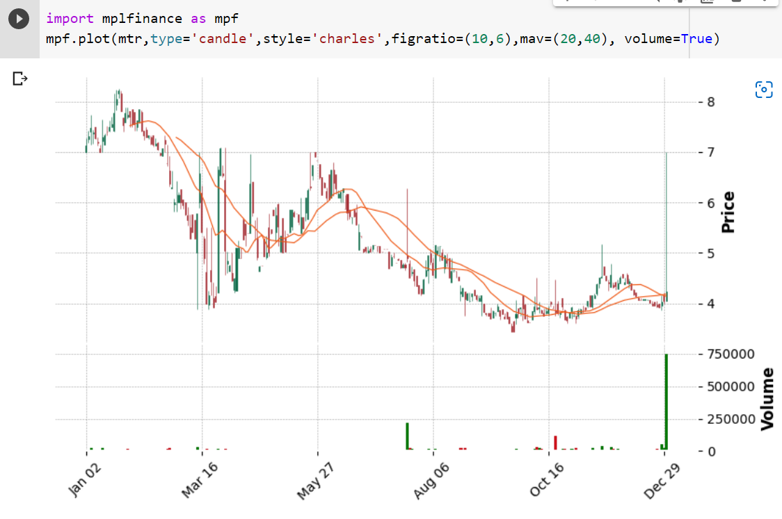

Slide 20
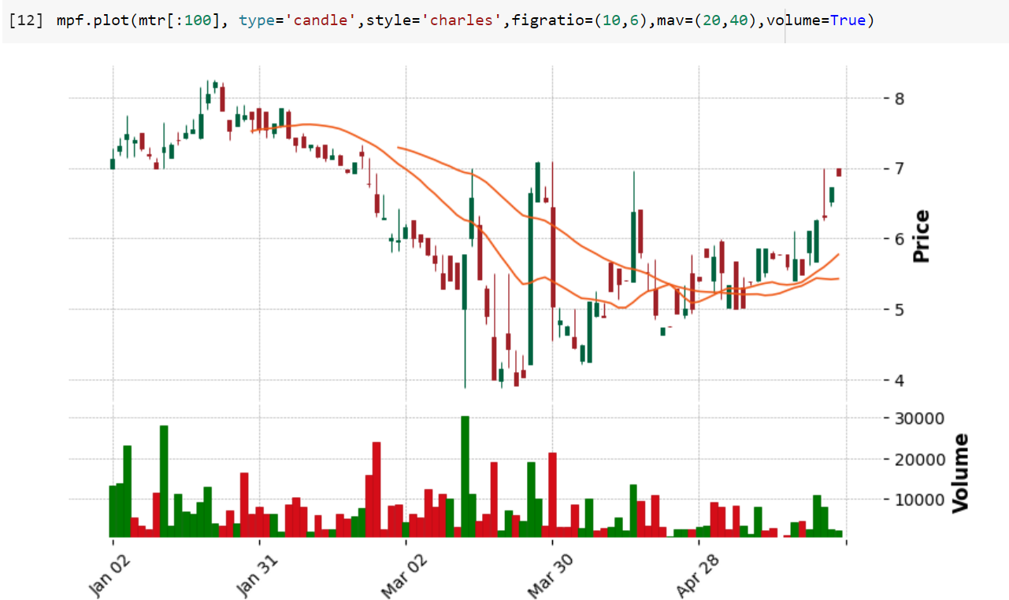

Slide 21
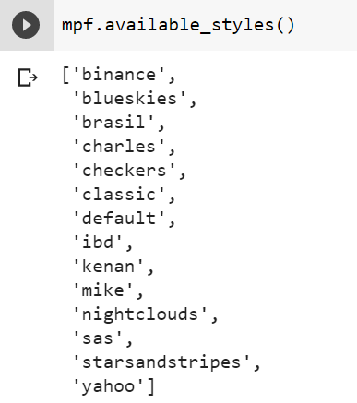
Try different candlestick styles supported by mplfinance

Slide 22
Stock prediction
Stock predication is one of the most critical topics in the finance industry

Slide 23
Technical Analysis vs Qualitative Analysis
Technical analysis:
mainly focuses on numerical stock data, such as closing price, opening prices, trading volume, ...
qualitative analysis:
based on external factors, such as political situation, social media, and company profile.
Note: This lecture focuses on the technical analysis, and next lecture focuses on the qualitative analysis.

Slide 24
Technical analysis
Simple strategies
Based on technical indicators like
Moving Average Convergence Divergence (MACD),
Relative Strength Indicator (RSI),
Channel Commodity Index (CC)
Average Directional Index (ADI)
Money Flow Index (MFI)
Exponential Moving Average (EMA)
...

Slide 25
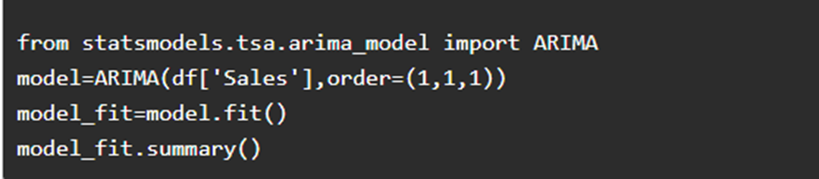
Technical analysis
Statistical methods for time series prediction
Example: Autoregressive Integrated Moving Average (ARIMA) model

Slide 26
Technical analysis
Machine Learning method
In this lecture, we will give two examples:
Write a simple program using the Linear_model library in SciKit-Learn to predict the price of a stock.
Build a LSTM deep neural network model using TensorFlow to predict prices.

Slide 27
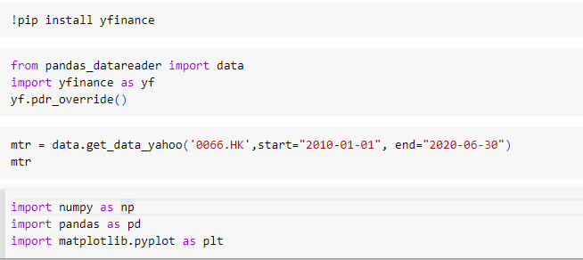
A simple program for stock price prediction
We will build a Linear-Regression model to predict stock price of next day.
First of all, we need prepare the training data.

Slide 28
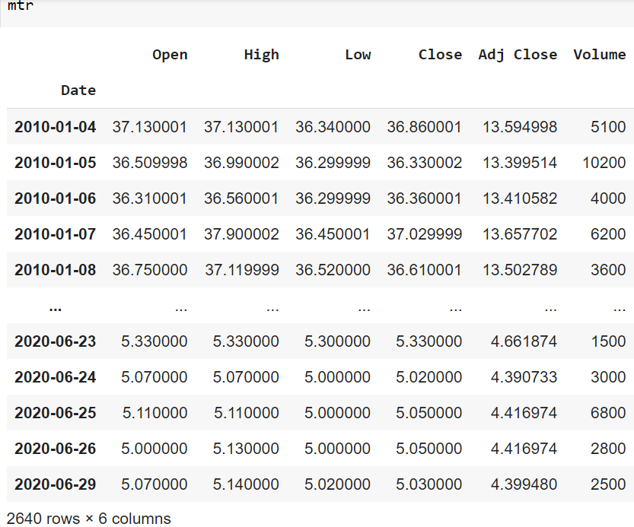
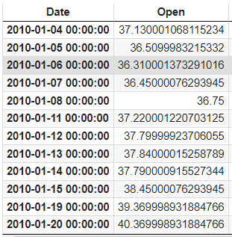
We want the following training data set
...

Slide 29

We want the following training data set
X
X
...

Slide 30

We want the following training data set

Slide 31
We want the following training data set
...
Training data

Slide 32
We want the following training data set
...
Training data
Labels
Ie., given today’s open (input), the model
needs to predict nextday’s open (the label).

Slide 33
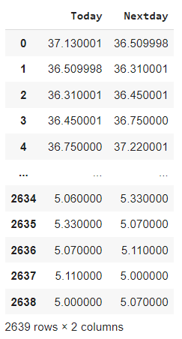
We want the following training data set
⇐
...
Training data
Labels
Ie., given today’s open (input), the model
needs to predict nextday’s open (the label).

Slide 34
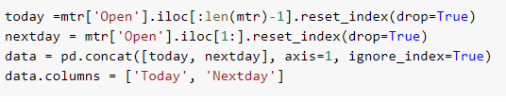
We want the following training data set
⇐

Slide 35
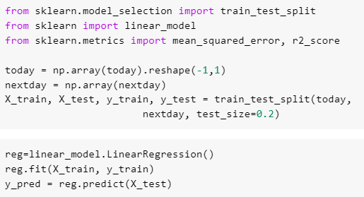
Next, we build the model using sklearn

Slide 36
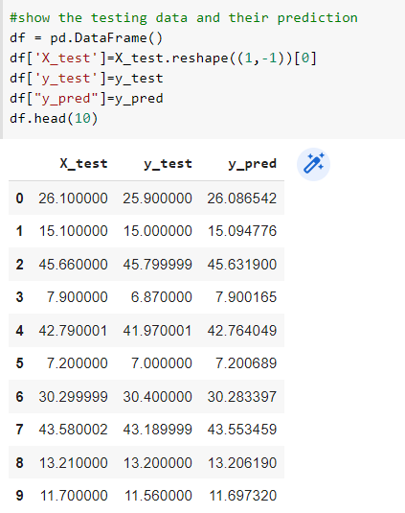

Slide 37
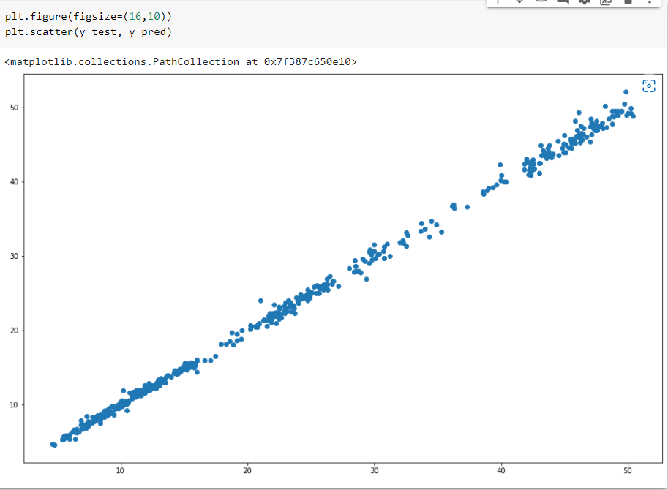

Slide 38
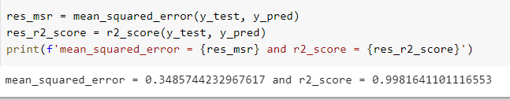
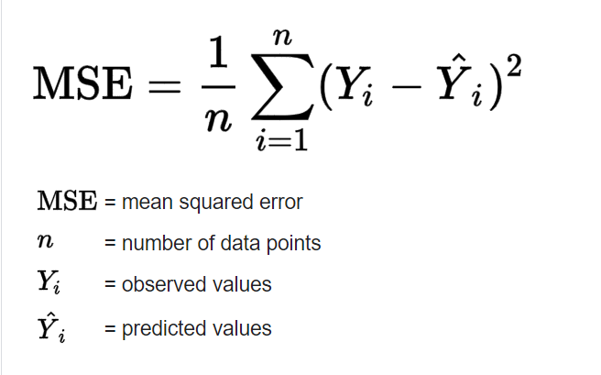
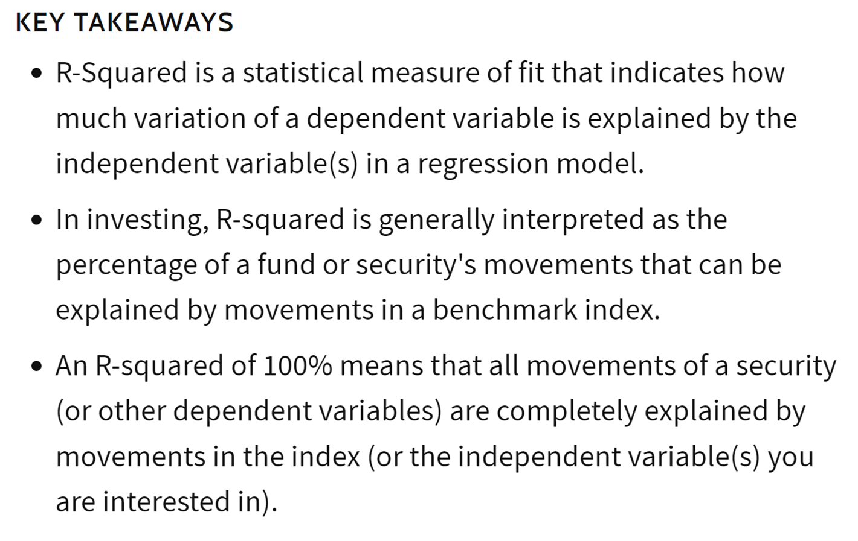

Slide 39
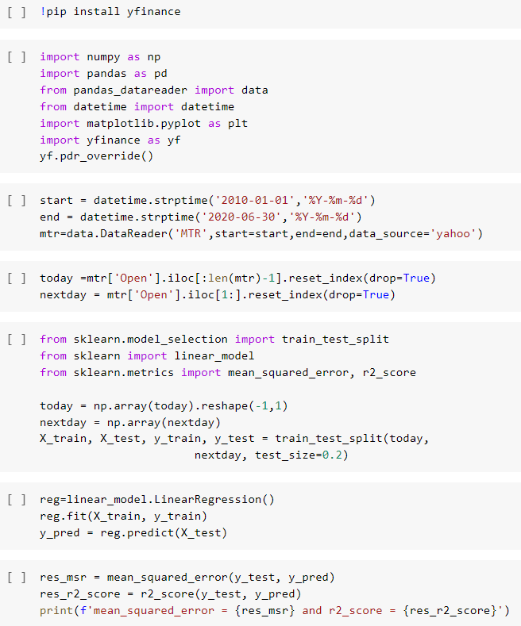
Final program, with those unnecessary
codes for explanations removed.

Slide 40
A deep learning method for predicting HengSeng index

Slide 41
LSTM: Long Short-Term Memory Network
Capable of learning long-term dependencies, especially in sequence prediction problems.
It has many applications
speech recognition
machine translation
handwriting recognition
speech synthesis
music modelling
protein structure prediction
…

Slide 42
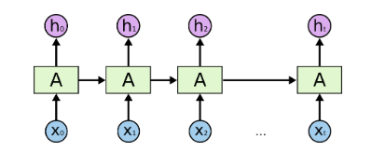
A traditional recurrent neural network

Slide 43
Long Short-Term Neural Network
“conveyor belt”: carry the output straight down to the entire chain, with only minor interactions.
Why “Long-Term”?

Slide 44
Long Short-Term Neural Network
This “gate” optionally let the information
flow in and out of the cell; i.e., enable the
cell to forget some past memory.
Why “Short Term”?
C_{t-1}
C_{t}
x
h_{t-1}
h_{t}
x_{t}

Slide 45
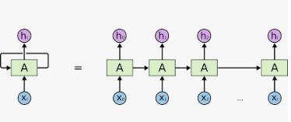
A LSTM cell

Slide 46
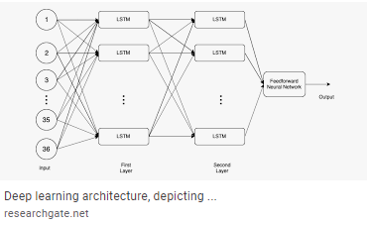
Our example will “stack-up” several layers of LSTM cells to build a deep LSTM network

Slide 47
The program

Slide 48
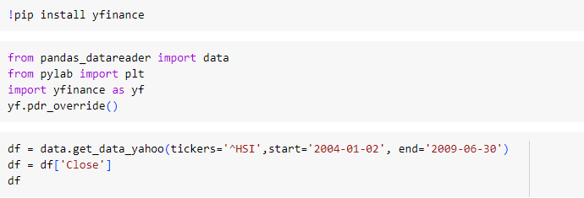
Step 1: Get the data

Slide 49
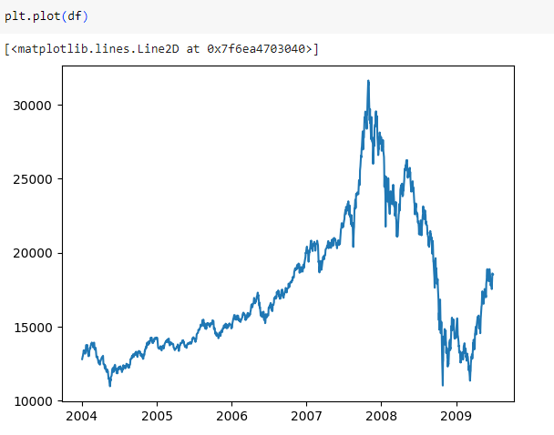
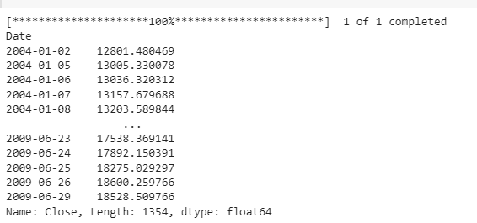
Step 1: Get the data

Slide 50

Step 2: Prepare the data

Slide 51
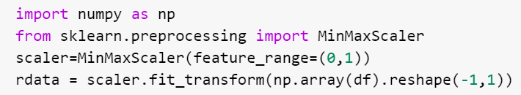
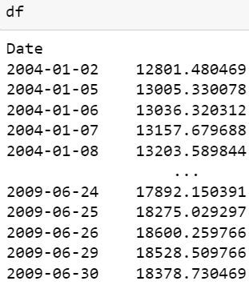
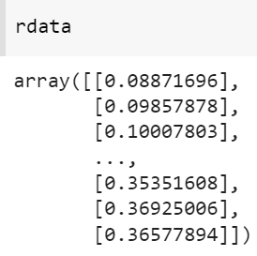
Step 2: Prepare the data
Scale these ~1500 data
points such that the min->0
max->1 by the mapping
(x-x.min)/(x.max – x.min)

Slide 52
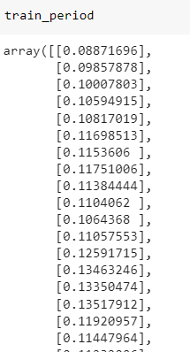
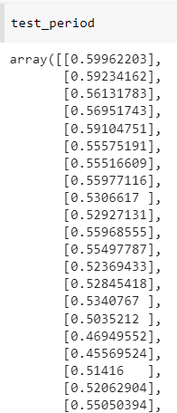
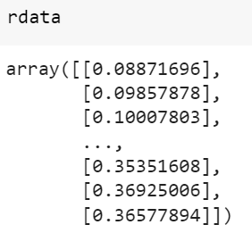
Step 2: Prepare the data

Slide 53
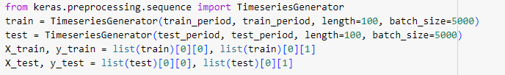
Step 2: Prepare the data

Slide 54
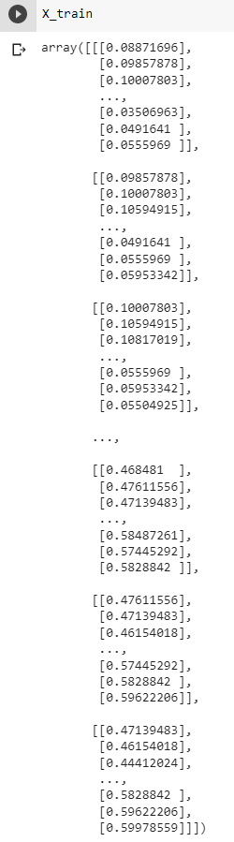
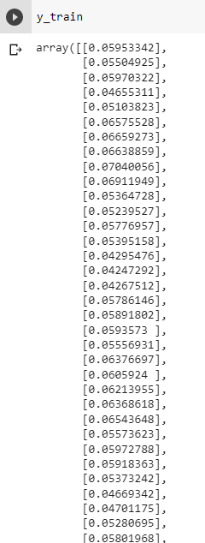
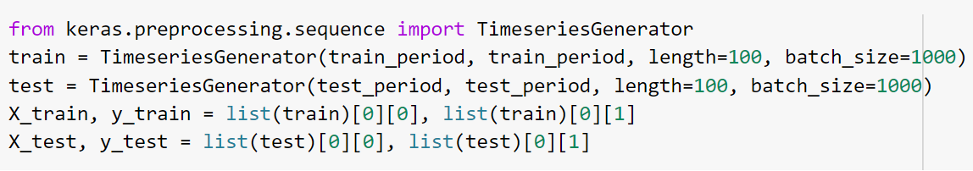
Step 2: Prepare the data

Slide 55
Build and train model

Slide 56
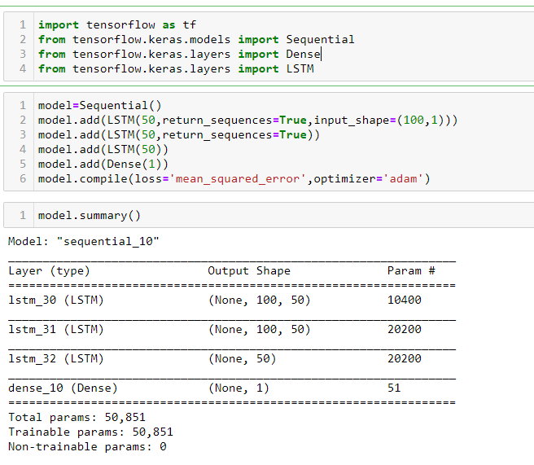

Slide 57
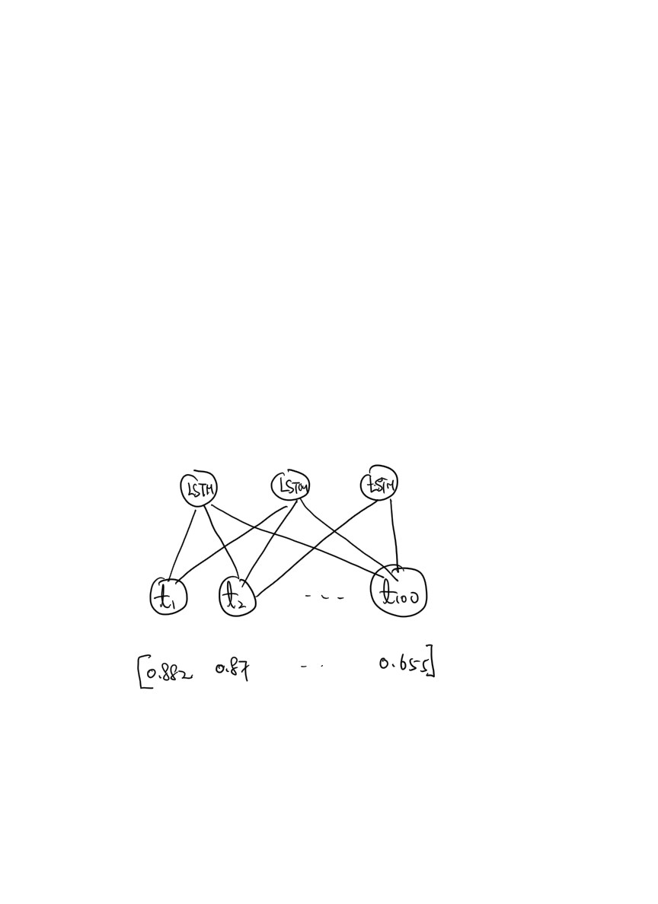

Slide 58
Note that each of the LSTM cells will generate
100 different h’s (one for each day).
By setting return_sequence
to True, all these 100 h’s will be the output
of that LSTM. Since we have 50 LSTM cells
in this layer, the overall shape of this network
output is (100, 50).

Slide 59
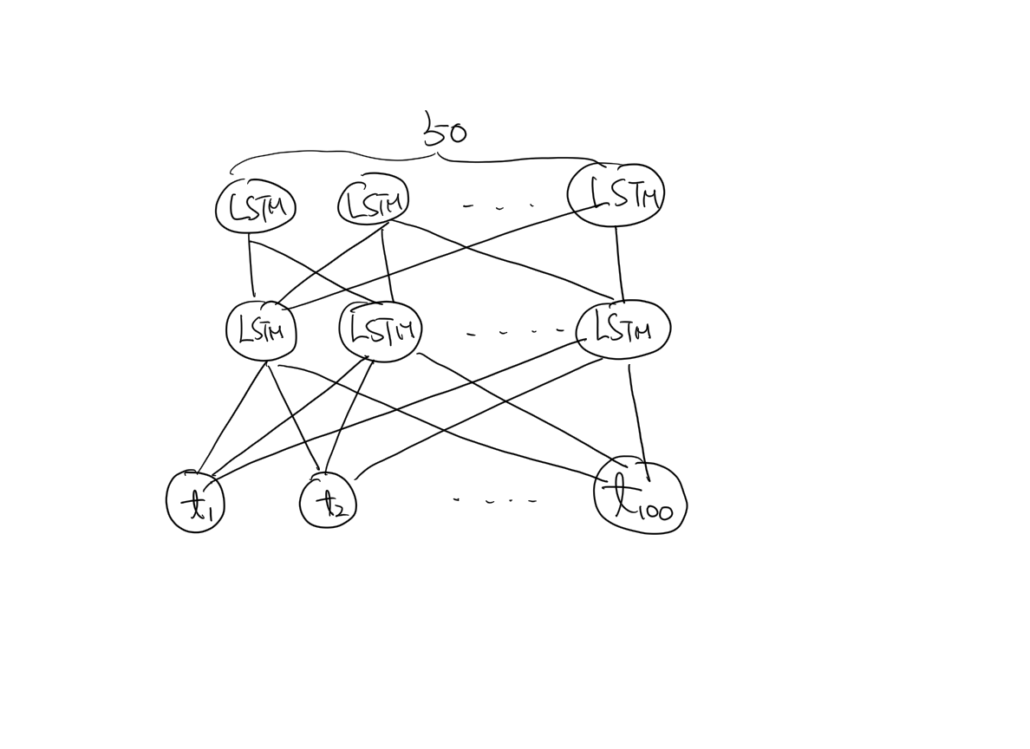
Since return_sequence=True,
each of the 50 LSTM cells will
ouput 100 h’s, the shape of the
network output is (100,50)

Slide 60
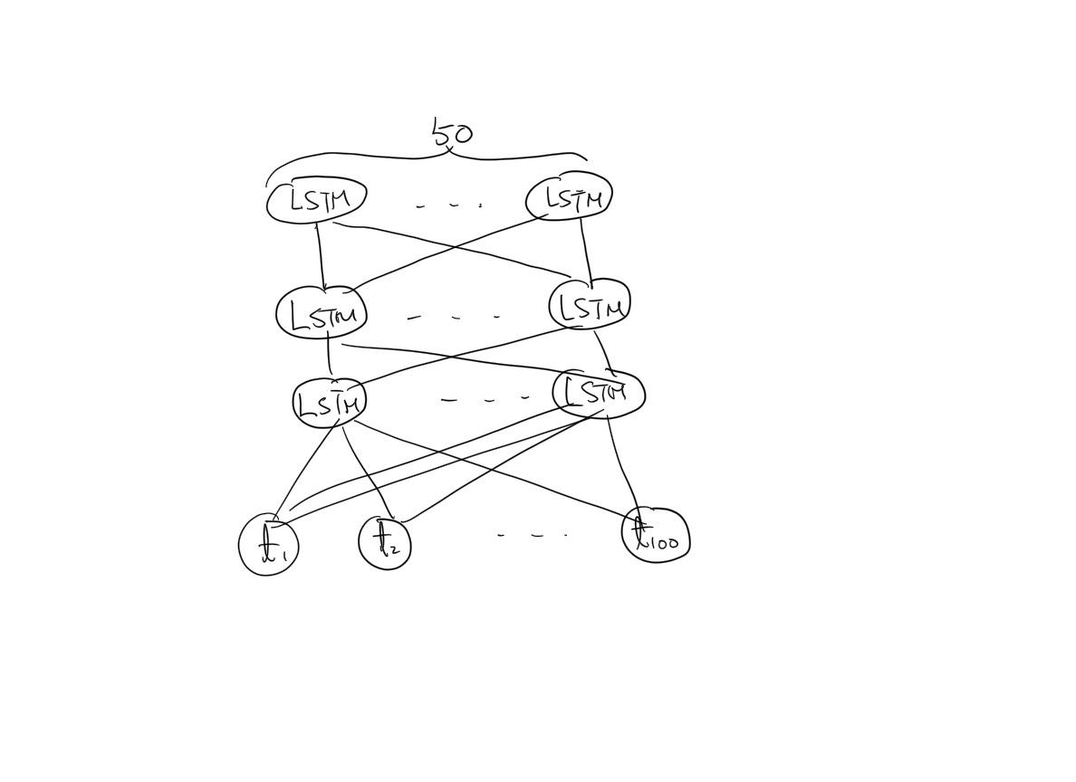
Since return_requence is NOT
set to True, each of the 50 LSTM
will only output the last h. Thus,
the output shape is (50,)

Slide 62
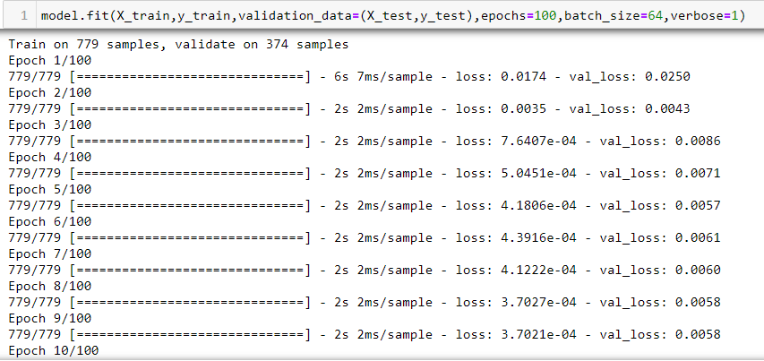

Slide 63
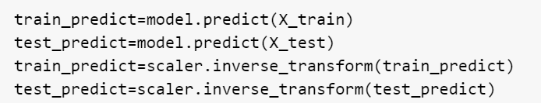
inverse-map
(0,1) to the true
stock prices

Slide 64
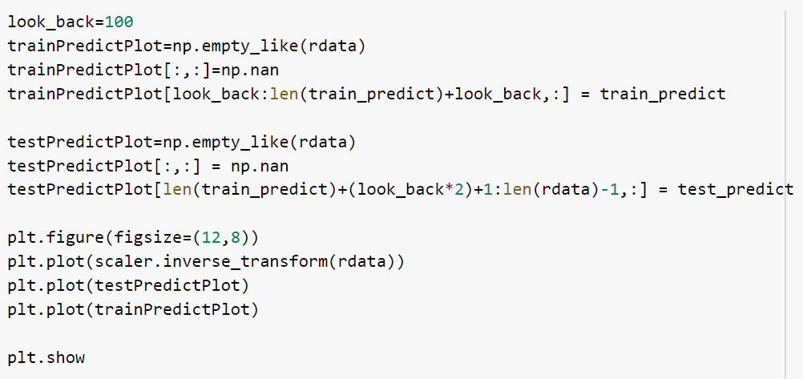
create an array with
same shape and type
as data

Slide 65
initialize every entry of
trainPredictPlot to NaN.

Slide 66
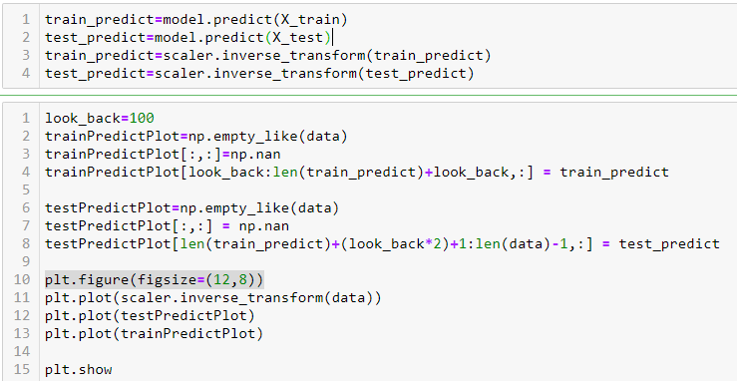
initialize every entry of
trainPredictPlot to NaN.

Slide 67
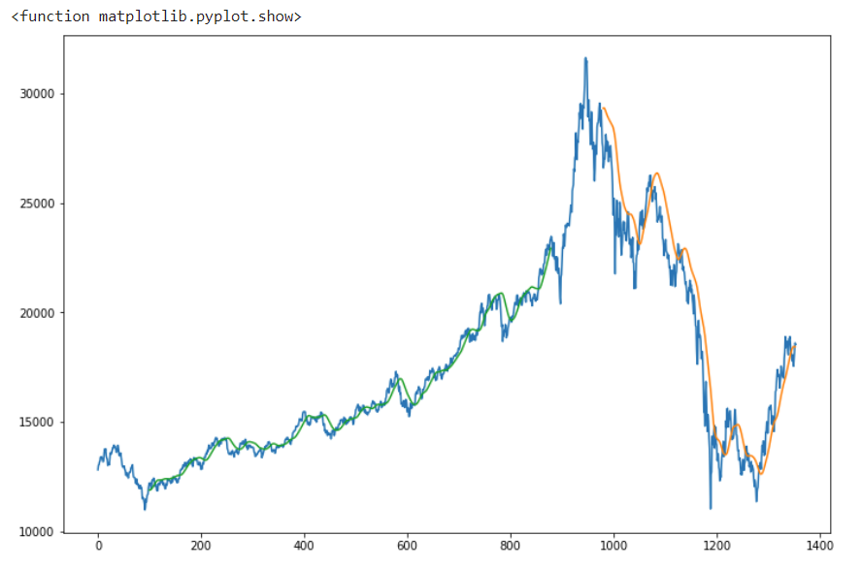
initialize every entry of
trainPredictPlot to NaN.

Slide 68


